Slide 1

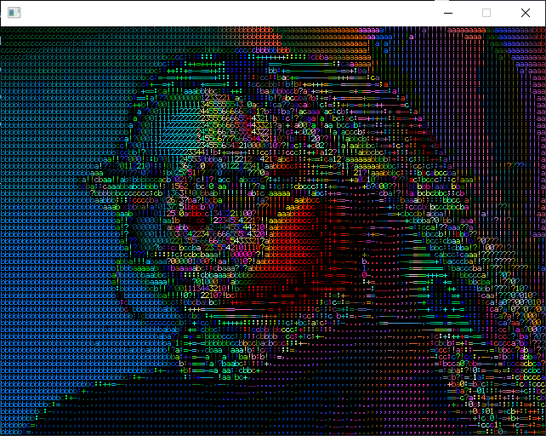
FPGA
Final project presentation
ASCII camera filter

Slide 2
Agenda
Camera module brief and requirements.
Design flow.
Main block diagram.
Components.
Block design.

Slide 3
Camera module brief
Project main purpose:
Sample live stream from camera module and stream live video to VGA port.
The live stream will have 2 modes:
Regular mode.
ASCII filter mode.

Slide 4

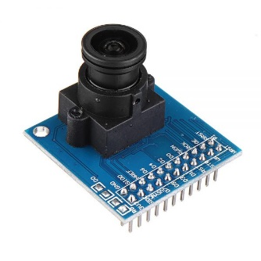
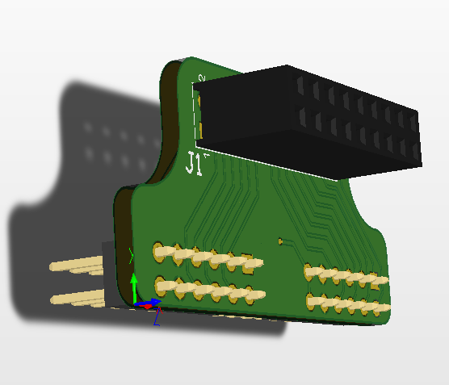
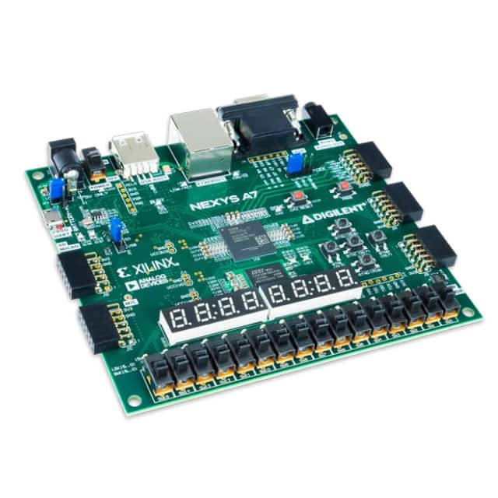
Block diagram and component
OV7670 to PMOD adapter
NEXYS A7 Board
OV7670
VGA Monitor

